Slide 1


PRESENTATION
By Abhishek Nagar

Slide 2
INTRODUCTION
My name is Abhishek, I’m B.com graduate student
and a certified in Data Analytics from Coursera. I’m working on different public domain projects with one of this. I’m looking forward to have a job to fulfill organization’s requirement and sharpen my analytical skills.

Slide 3
PROJECT GOALS
This project is to analyse a public domain dataset of a Pizza shop on MySQL.
This project helps to understand the fundamentals about queries i.e. how the skills are applied in practical part of project.

Slide 4
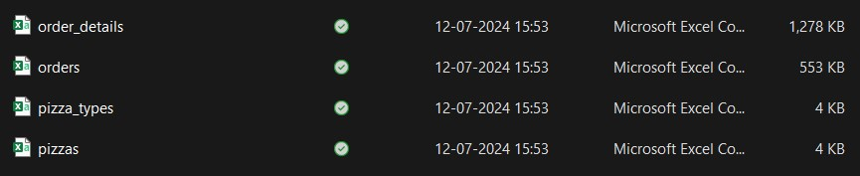
Dataset of Pizza shop

Slide 5


Retrieve the total number of orders placed.

Slide 6
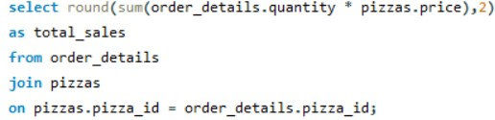

2. Calculate the total revenue generated from pizza sales.

Slide 7
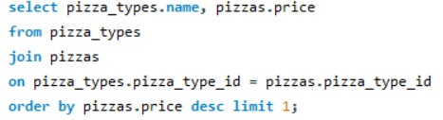

3. Identify the highest-priced pizza.

Slide 8
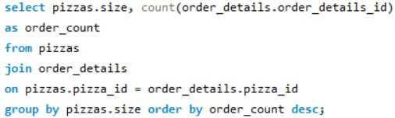
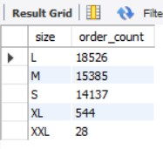
4. Identify the most common pizza size ordered.

Slide 9
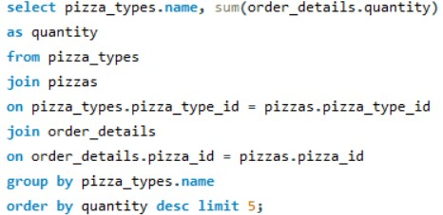
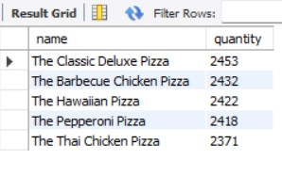
5. List the top 5 most ordered pizza types along with their quantities.

Slide 10
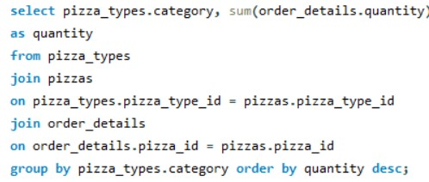
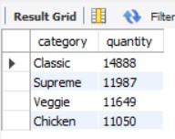
6. find the total quantity of each pizza category ordered.

Slide 11

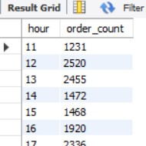
7. Determine the distribution of orders by hour of the day.

Slide 12

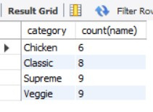
8. find the category-wise distribution of pizzas.

Slide 13
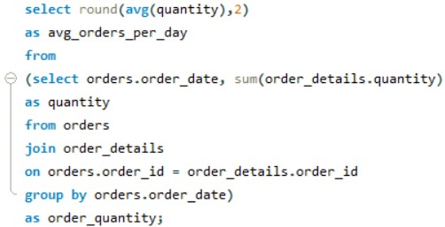

9. Group the orders by date and calculate the average number of pizzas ordered per day.

Slide 14
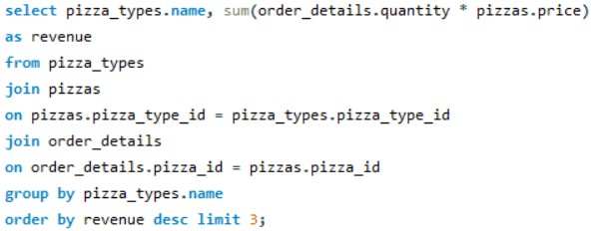
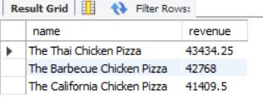
10.Determine the top 3 most ordered pizza types based on revenue.

Slide 15
THANK YOU

